Slide 1
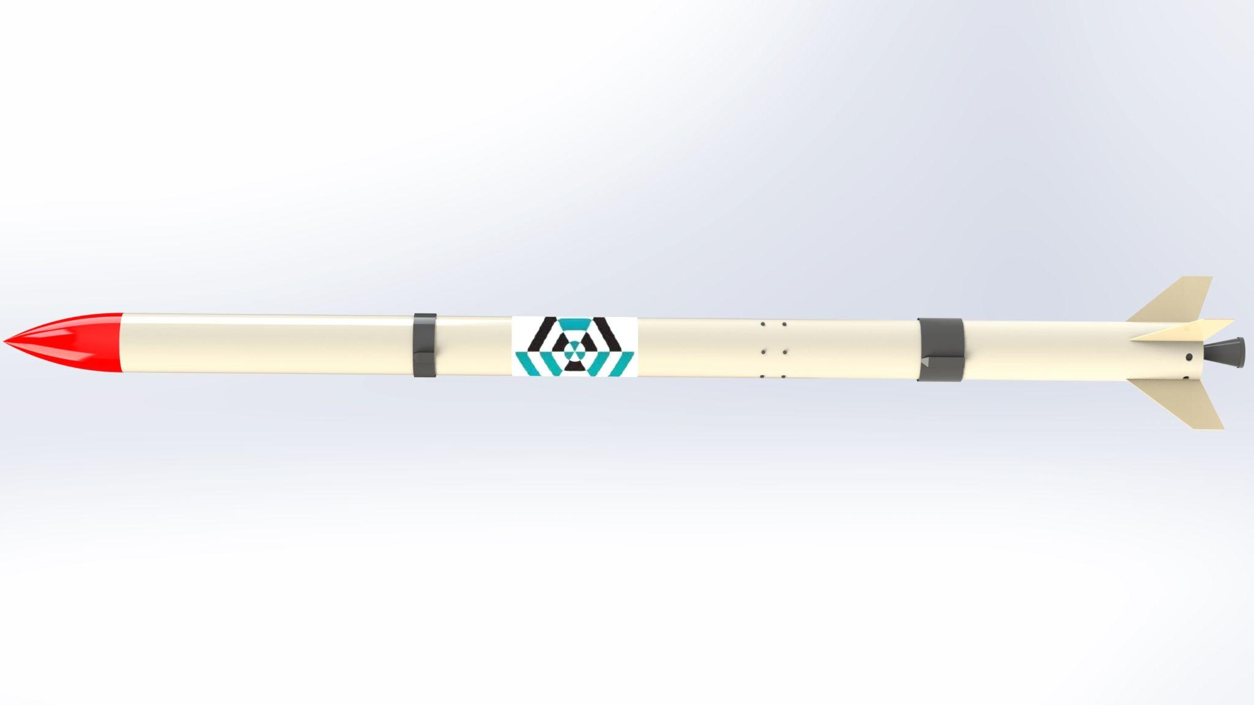
Airframe Progress Report
-15/3/2023-
no_reply@example.com

Slide 2
ABOUT AIRFRAME TEAM
The airframe team is about building, fabricating and coming up with the rockets body.
It entails structural analysis of the rockets body, calculation of forces that affect the rocket in its flight path, compressive and buckling loads among other aerospace properties that affect the rocket.
The airframe refers to the body of the rocket, or the housing that will hold other components of the rocket such as the avionics bay, the payload, the parachute and the motor which will be the engine of the rocket.

Slide 3

PROJECTION
The Nakuja N3 rocket was proposed to have an aluminum airframe as an improvement from the previous two versions of the Nakuja rocket which were made using Fiberglass material.
Therefore to determine which grade of Aluminum to use based of on the structural integrity, aerospace properties we needed to do some research

Slide 4
ADVANTAGES OF ALUMINUM FABRICATION
Aluminum is an easy metal to work with thanks to its comparative softness, corrosion resistance, and recyclability.
Aluminum is also malleable, which makes it highly adaptable to shaping and extension.
Its non-toxicity has made it a popular choice for food preparation machinery, and its reflective and non-combustive properties have also cemented its place in lighting.

Slide 5
DISADVANTAGES OF ALUMINUM FABRICATION
At the same time, this softness and weakness compared to stainless steel can make for less sturdy end products.
Thanks to its thermal conductivity, many types of aluminum can also be difficult to weld for the inexperienced because it can easily be melted through.
Certain stresses can also cause aluminum to break, as it can be brittle in some ways from manufacturing processes.
There is the issue of low melting point, which will require the need of an insulation material after fabrication.

Slide 6
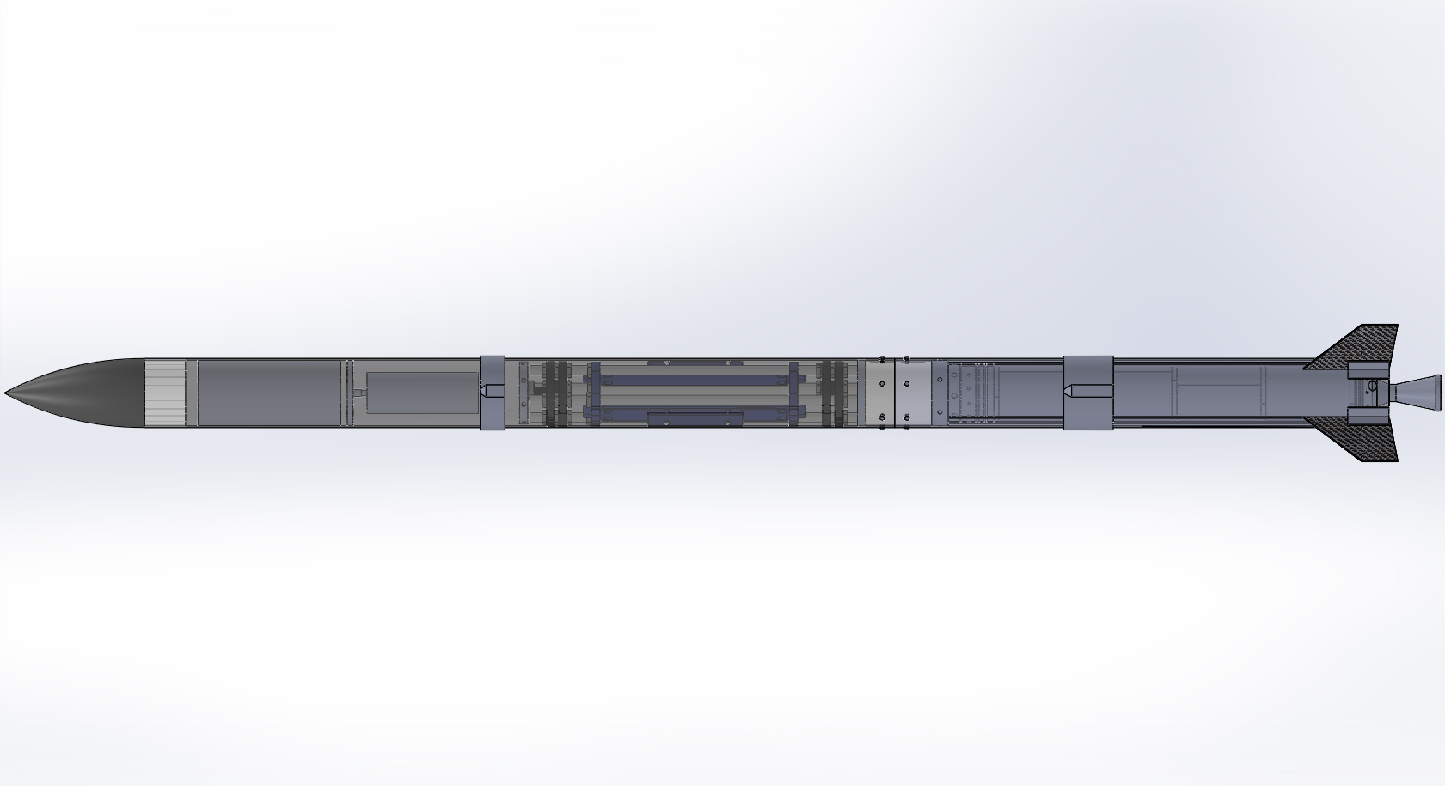
THE PARTS OF THE AIRFRAME
Nosecone
Parachute ejection
Avionics bay
Couplers
Bulkhead
Solid motor
Fins
Nozzle

Slide 7
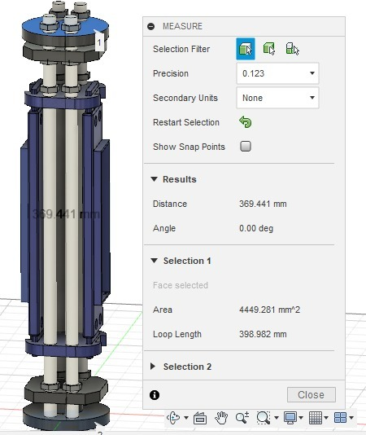
THE AVIONICS BAY
The avionics bay can be termed as the house that holds the electronics components that control the flight path od the rocket.
These include the flight computer PCB’s, the parachute ejection system, the cameras and antenna of the N3 rocket.
The avionics bay consists the electronics bay which on one side holds the battery and on the other side, will have some of the PCB’s laid on it.
It also has a holder that gives it the orientation of the airframe foe ease of assembly and dis-assembly during and after launch.

Slide 8
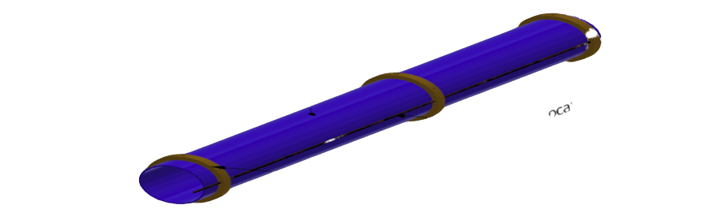
THE MOTOR CASING
The motor mount tube casing can be thought as the housing of the solid motor.
The center ring holds the motor in place within the motor mount tube.
Motor mount tube
Center ring

Slide 9
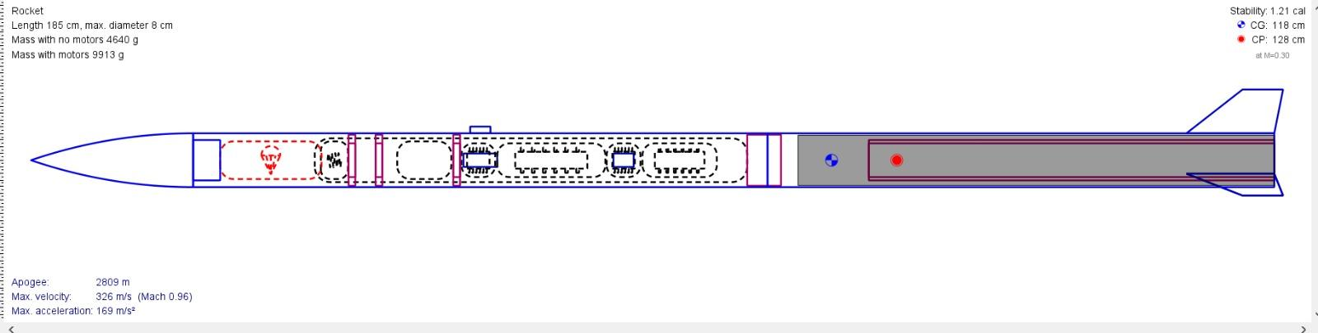
To get the rocket parameters such as the velocity of the rod, the apogee(altitude), the stability margin as well as the weight of the rocket, we used the Open-Rocket software simulation
The N3 rocket was to get to an altitude of 2000m and from the simulation records highlighted in blue we achieved an apogee of 2230m

Slide 10
LAUNCHPAD AND LAUNCHROD
The launchpad is where the rocket will be launched while the launch rod is a fixed structure on the launchpad that will hold the rocket at 90 degrees to align it in its initial flight trajectory.
For the N3 rocket we chose to go with a launch rail instead since it would be difficult to make a groove on the aluminum body due to its tiny thickness.
We opted to design an adjustable launchpad + launch rail design to allow flexibility of launching the later Nakuja models as seen in the next slide.

Slide 11
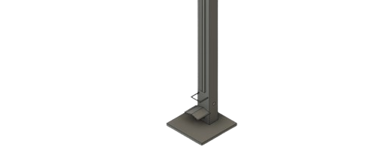
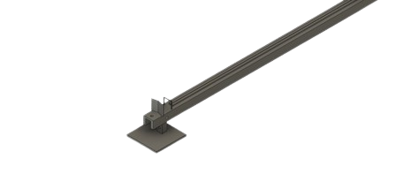
Adjustable launch rail
Launchpad

Slide 12
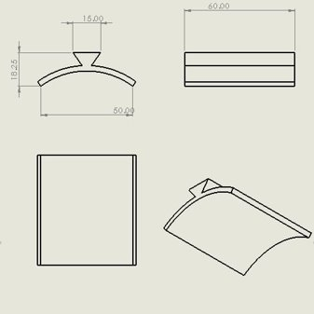
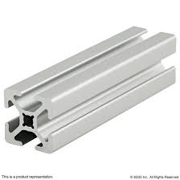
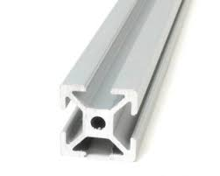
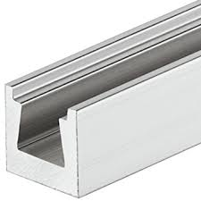
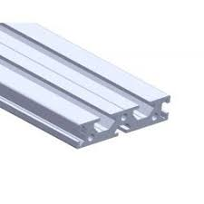
LAUNCHLUG AND LAUNCHRAIL
Initial designs for the rail and lug
The proposed rail design

Slide 13
Fabrication of the airframe
The following slides show the fabrication process of the fiber glass

Slide 14
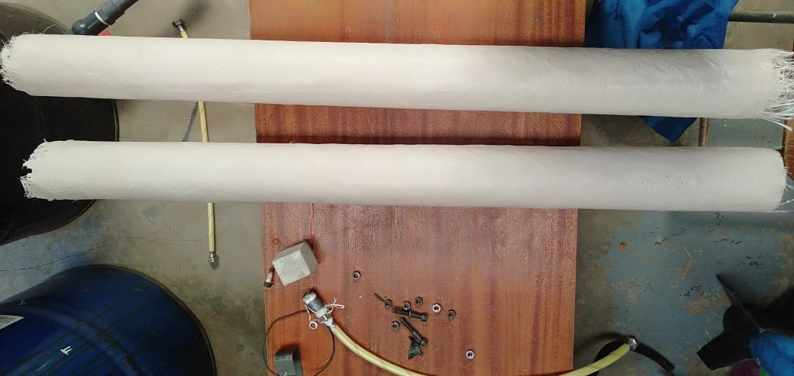
Height: 105cm
Internal Diameter = 8.1cm
Thickness = 0.3mm
Density = 1.479g/cm³
The thickness slightly changed bearing to the fact we used the fibremat, and nylon.

Slide 15
Calculations of density
FABRICATED AIRFRAME 1:
HEIGHT : 105 cm
THICKNESS: 0.3cm
MASS: 1326 g
AVG CIRCUMFERENCE: 29.4 cm
Volume = π *(R² -r²)* h
Volume = 896.38cm³
Density = mass / volume
Volume = 1.479g/cm³
Actual GFRP density lies between
1.25 - 2.5 g/cm³

Slide 16
OPENROCKET SIMULATION:
From the open rocket simulation shown in the next slide, with the fabricated density, we get our component mass as 1053g
HEIGHT : 91 cm
THICKNESS: 0.3cm
DENSITY: 1.479g/cm³
Performing a correlation calculation to get the estimate mass and compare what we have in openrocket:
From the correlation calculation, the mass is 1149.2g
Which is a 9% discrepancy from the simulation.
105cm = 1326g
91cm= ?

Slide 17
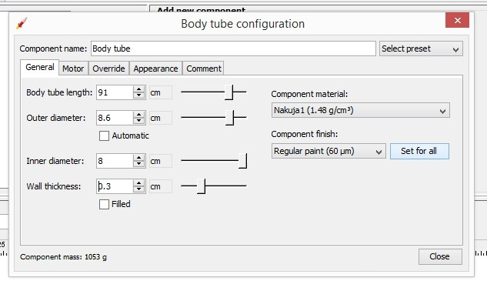

Slide 18
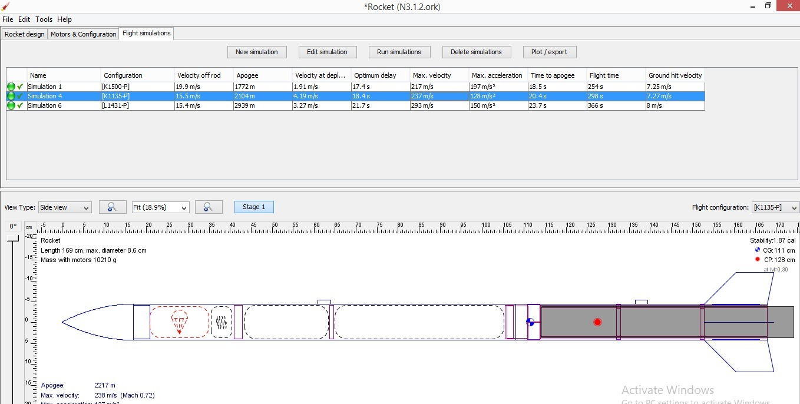
Apogee = 2104m Total mass = 10kg Stability= 1.87 cal

Slide 19
Fabrication of the airframe
The following slides show the fabrication process of the aluminum

Slide 20
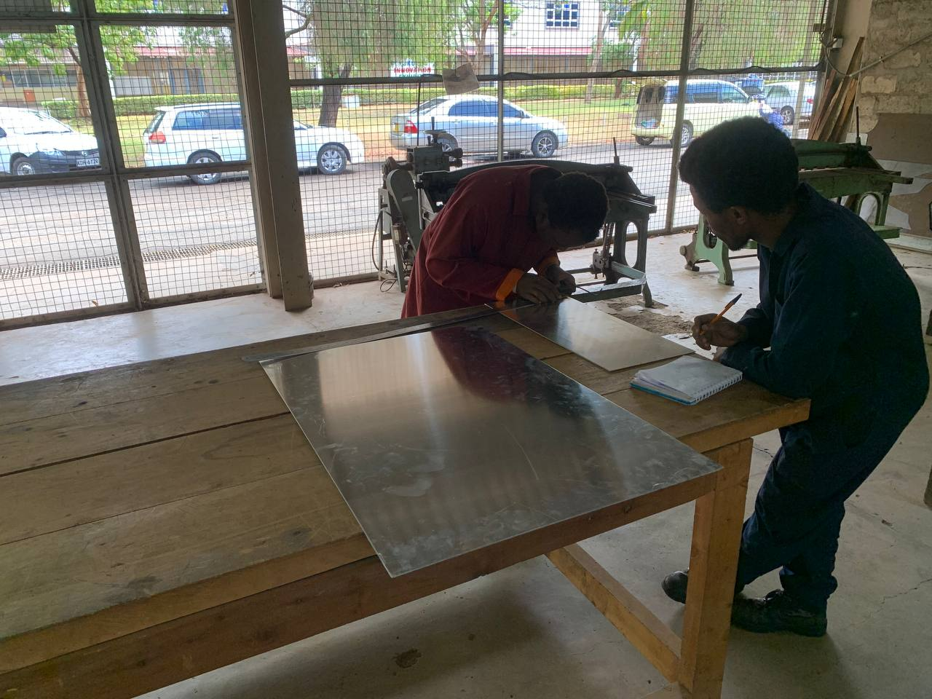
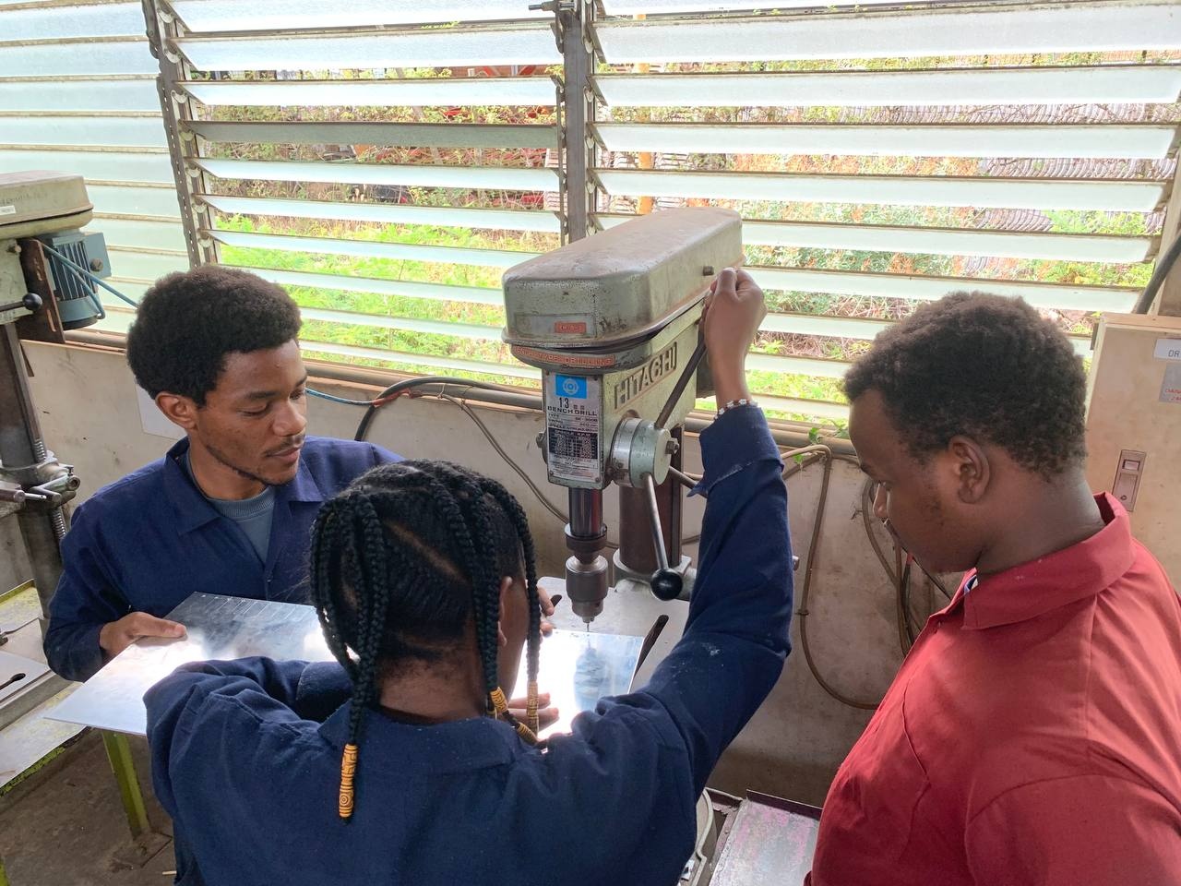
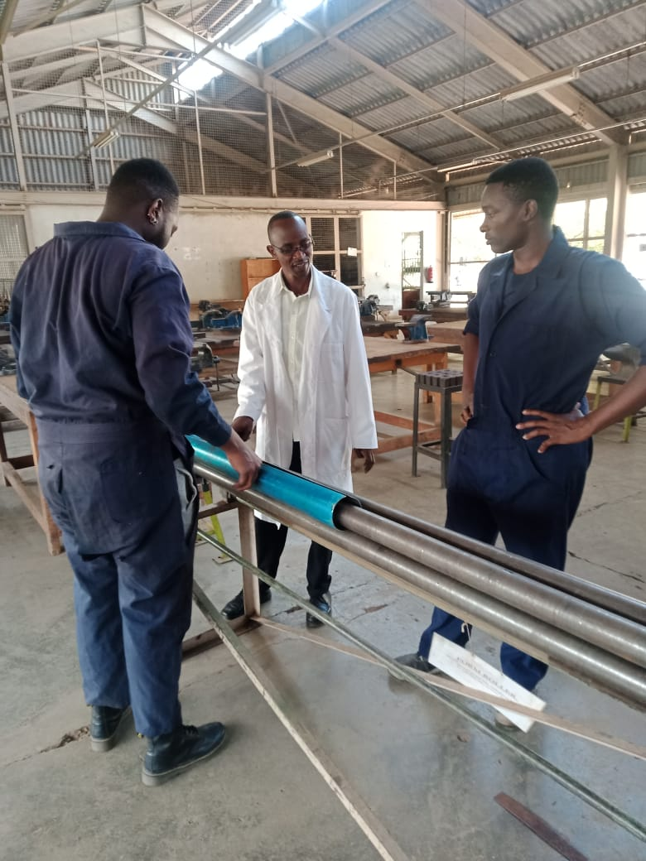
PROCEDURE
Marking out points to be drilled
Drilling
Rolling

Slide 21
Fabrication of the fin alignment jig
The following slides show the fabrication process of the fin alignment jig
The jig will help align the fins on the airframe.
The fins play a major role on the aerodynamic properties of the rocket as such the MUST be at 90 degrees alignment with the airframe.

Slide 22
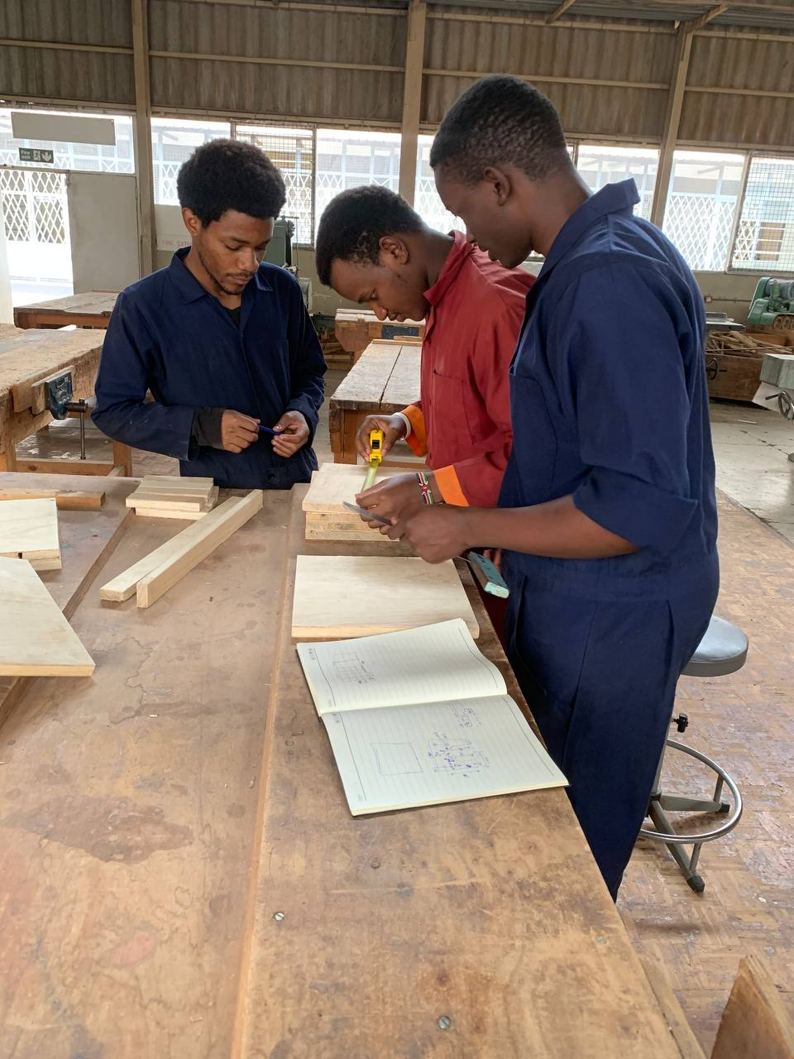
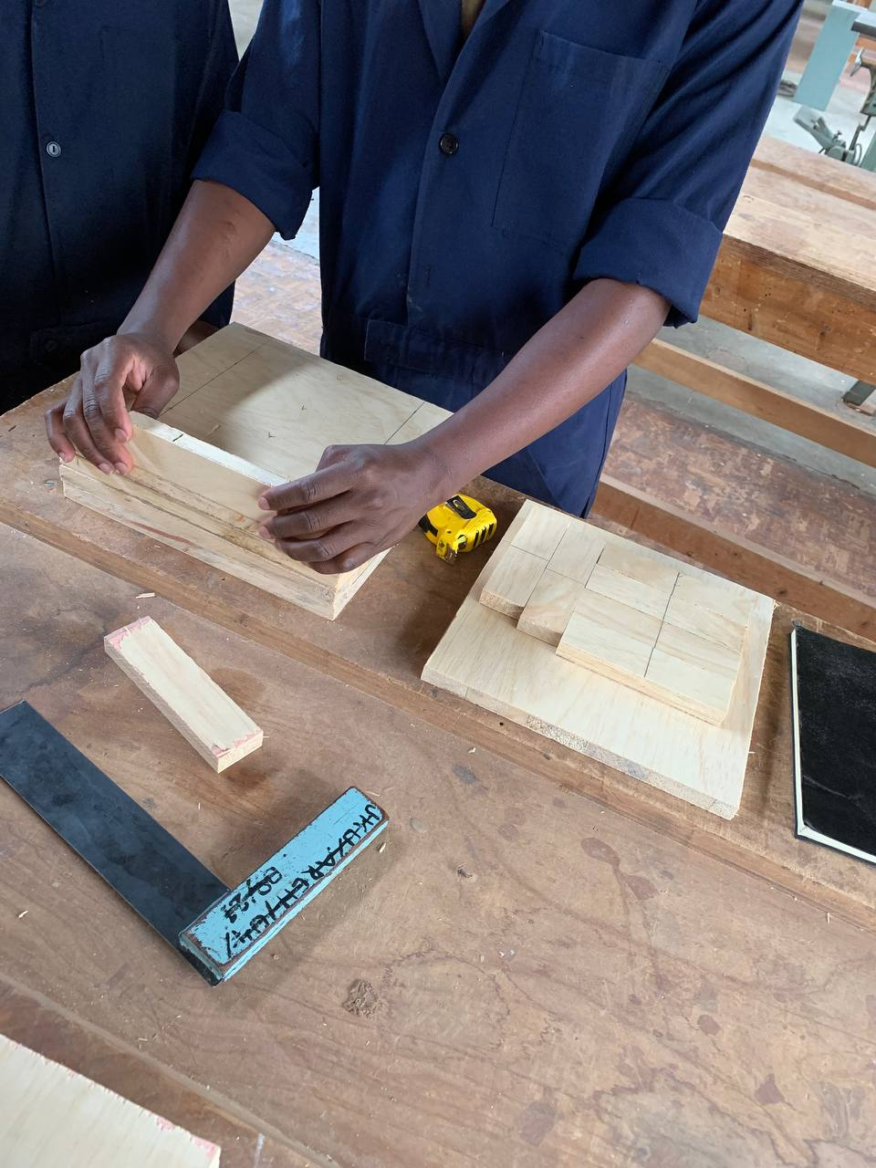
FIN ALIGNMENT JIG
The fin alignment jig will be used to align the fins on the rocket's airframe for perfect alignment

Slide 23
THANKYOU

